Slide 1



A Case Study on Scaffolding Exploratory Data Analysis for AI Pair Programmers
CHI 2023 Student Research Competition
Haoquan Zhou & Jingbo Li, Shanghai Jiao Tong University
April, 2023

Slide 2

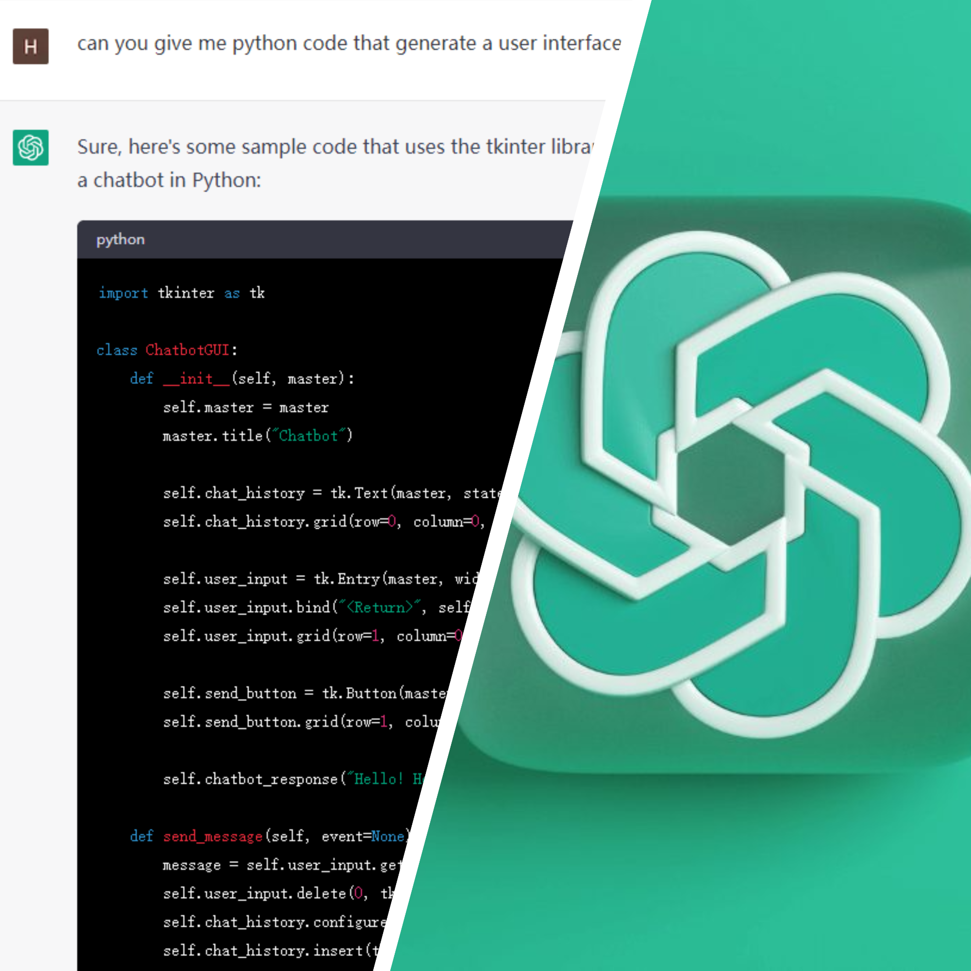
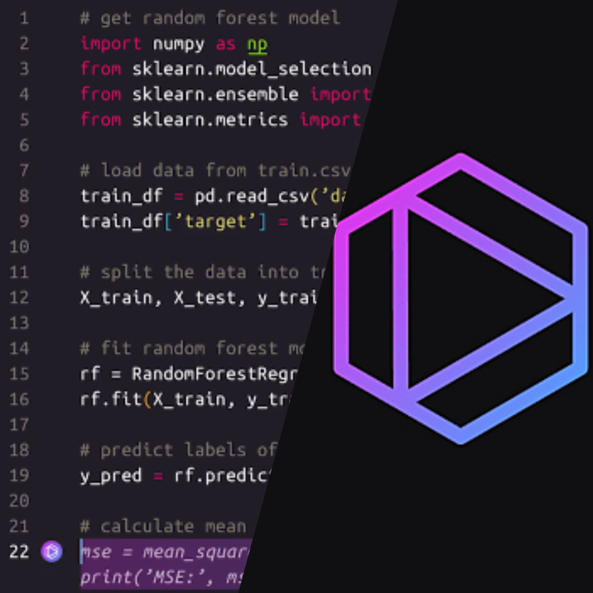
Background
LLM Code Generation
Large Language Models can generate code based on descriptive prompts.
GitHub Copilot
ChatGPT/GPT4
Tabnine
Notes:
TODO: Add icons and pictures. Remove the later two boxes and move Copilot to the center at the end

Slide 3



Background
Past Works
Researches in the past focus on the performance of GitHub Copilot for general purpose programming, like building an application.
Can be helpful 61% ~ 91% of the time depending on language used
Can almost solve all fundamental algorithm problems
Can save the programmers some time in some cases
But data analysis is different from general purpose programming…
[Nhan Nguyen and Sarah Nadi. 2022. An Empirical Evaluation of GitHub Copilot’s Code Suggestions. In Proceedings of the 19th International Conference on Mining Software Repositories (Pittsburgh, Pennsylvania) (MSR ’22)] [Arghavan Moradi Dakhel, Vahid Majdinasab, Amin Nikanjam, Foutse Khomh, Michel C. Desmarais, Zhen Ming, and Jiang. 2022. GitHub Copilot AI pair programmer: Asset or Liabilit]
[Priyan Vaithilingam, Tianyi Zhang, and Elena L. Glassman. 2022. Expectation vs. Experience: Evaluating the Usability of Code Generation Tools Powered by Large Language Models. In Extended Abstracts of the 2022 CHI Conference on Human Factors in Computing Systems (New Orleans, LA, USA) (CHI EA ’22)]

Slide 4
Background
Question
Data Analysis
General Programming
Data Driven Approach
Target Driven Approach
“To DIG”
“To BUILD”
Focus more on outputs
Focus more on algorithms
Notes:
Use “outputs” or “results”

Slide 5
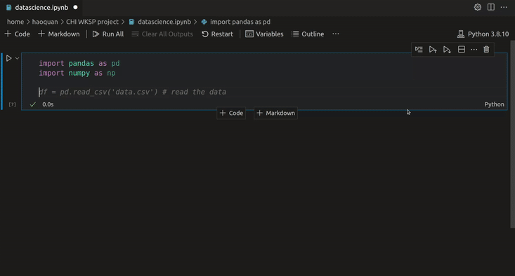
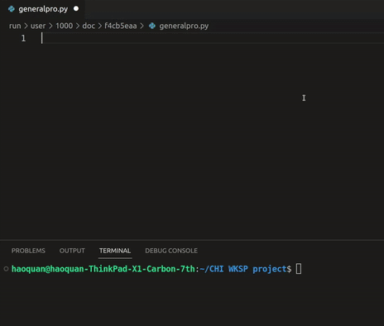
Background
Question
Data Analysis
General Programming
Notes:
Use “outputs” or “results”

Slide 6
Background
LLM Code Generation
Large Language Models can generate code based on descriptive prompts.
Question
How data scientists interact with automatic code generating tools?
Prompts and interaction pattern?
Potential drawbacks?
Improvements?

Slide 7

Methods
Tasks
Scenarios
Data Cleaning Task
New to data analysis
Data Science Students
Prompts Recovery
Data Visualization Task
Familiar with other data analysis tools like Excel
N = 5
Data Analysis Task
Familiar with data analysis using Python

Slide 8



Results & Findings
Overall Results
Among all 15 task-scenario pairs:
Low Success Rate
40%
Time Consuming
11 min (15 min given)
Failure due to Bugs and Non-workable Code
Must have problems cooperating with AI…

Slide 9
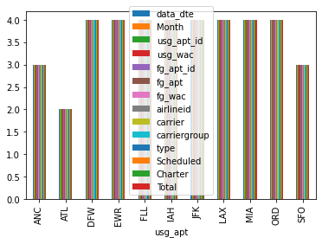
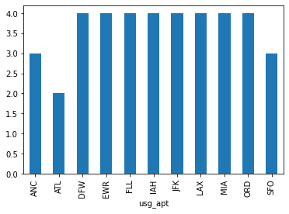
Results & Findings
Prompts Construction
By reconstructing original prompts, we find effective prompts need:
Choose Terminology Wisely
# Group by airport and count the number of rows. Plot the number of rows in a bar chart.
# For each airport, count the number of appearances. Plot the appearance in a bar chart.

Slide 10
Results & Findings
Prompts Construction
By reconstructing original prompts, we find effective prompts need:
Arrange and Repeat Words
# Then, for each year, find the top 10 airport with the highest number of rows.
# In df3, for each Name, if it has multiple rows, find the sum of all Global Sales, and store them in new dataframe multi.
# Then, find the top 10 airport with the highest number of rows for each year.
# In df3, for each Name, if it has multiple rows, find the sum of all Global Sales for each Name, and store them in new dataframe multi.

Slide 11
Results & Findings
Prompts Construction
By reconstructing original prompts, we find effective prompts need:
Think in a Programming Way
Instead of scaffolding the problem at a high level:
Wisely use domain-specific terminologies
Arrange words in a self-contained order
Transform prompts to be more mathematical and quantitative

Slide 12

Results & Findings
Interact with Copilot
Over-trust
Under-trust
Copilot
# Find the longest missing timestamp period for each user
df[‘time_diff’] = df[‘time’].diff()
df.groupby(‘user_id’)[‘time_diff’].max()
Describing a problem to GitHub Copilot is more difficult than coding up the problem by myself. (P4)
Expected
df[‘time_diff’] = df.groupby(‘user_id’)[‘time’].diff()
df.groupby(‘user_id’)[‘time_diff’].max()

Slide 13



Limitation & Future Work
Limitations
This work only has a small sample size of 5. Finding might not be persuasive enough.
We find it hard to reproduce errors. The answer given by Copilot varies for identical prompts.
Future Work
Instead of whether the generated code can accomplish “what I need”
Users may care more about how to generate “what I need”.
If GitHub Copilot itself can give advice on prompt constructions, it would be more convenient for users to modify the prompts.

Slide 14

A Case Study on Scaffolding Exploratory Data Analysis for AI Pair Programmers
CHI 2023 Student Research Competition
Haoquan Zhou, zhouahquan1660@sjtu.edu.cn
Jingbo Li, ljb1456319150@sjtu.edu.cn
Both upcoming master’s students from Umich
Supplementary Materials

Slide 15
Thank You!

